Slide 1

IBM Data Analyst Capstone Project
KRUPAL BAMANIYA
DECEMBER 2023

Slide 2

OUTLINE
Executive Summary
Introduction
Methodology
Results
Visualization – Charts
Dashboard
Discussion
Findings & Implications
Conclusion
Appendix

Slide 3

EXECUTION SUMMARY
Data Contextualization and Analysis goal
Methodology Description
Data Gathering
Data Analysis
Data Visualization
Results presentation supported with Graphs and Trends
Analysis and Interpretation of the discovered outcomes along with their broader implications.
The Ultimate Conclusion drawn from the conducted research.

Slide 4

INTRODUCTION
In this IBM Capstone we analyzed a subset of a 2019 survey conducted by Stacked Overflow, a popular website for Developers around the world.
The nature of this analysis, is to become more aware of technologies currently being used and which direction these technologies will have in the future.
This report is to find and analyze the trend of technology usage of data Professional, including current usage and future trend.

Slide 5

METHODOLOGY
Collect survey data & Explore its content
Web Scraping
APIs
Request Library
Data Wrangling
Exploratory Data Analysis (EDA)
Analyzing data distribution
Handling outliers
Correlations
Data Visualization
Highlight distribution of data, relationships, compositions and comparison of data
Dashboards

Slide 6

RESULTS

Slide 7
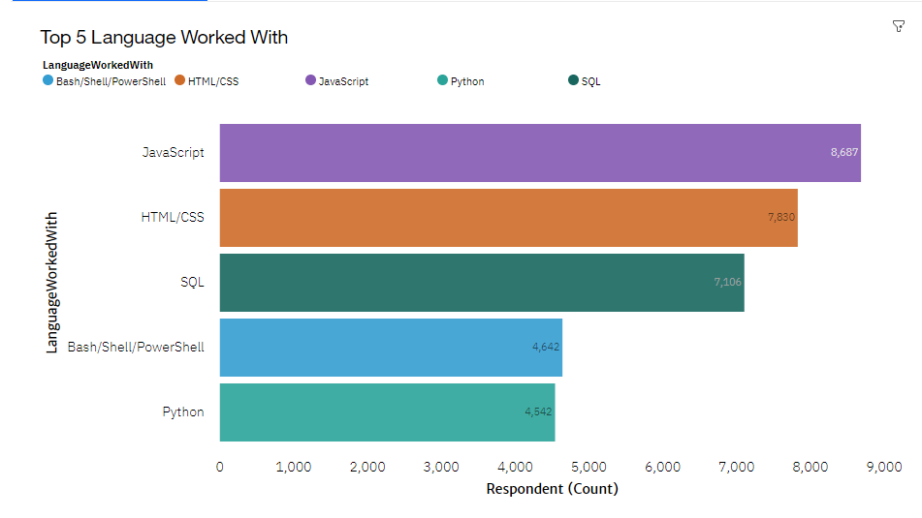
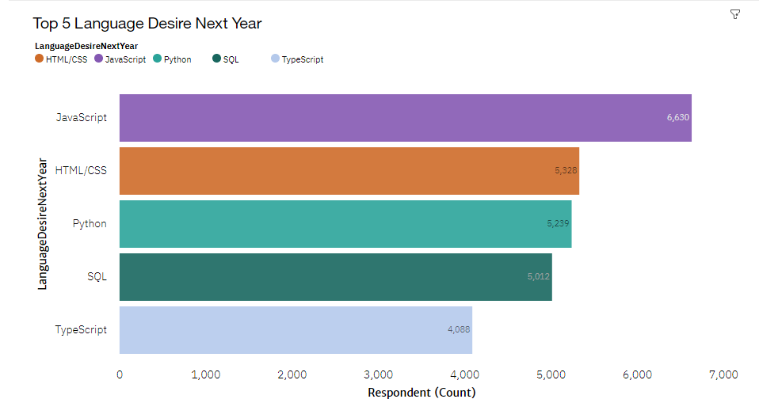
PROGRAMMING LANGUAGE TRENDS
Current Year
Next Year

Slide 8
PROGRAMMING TRENDS-FINDINGS & IMPLICATIONS
Findings
JavaScript and HTML/CSS are the most popular programming Languages and are likely to stay that way.
SQL is a very prominent language and will remain so.
Python and TypeScript are trending upwards whereas Bash is losing popularity.
Implications
Web development is in high demand and JavaScript and HTML are the kings in that field.
SQL language for big data and querying remains the most popular choice.
With work in AI and ML on the rise, Python will continue its upward trajectory.
TypeScript's trend may possibly de-throne a king in the near future.

Slide 9
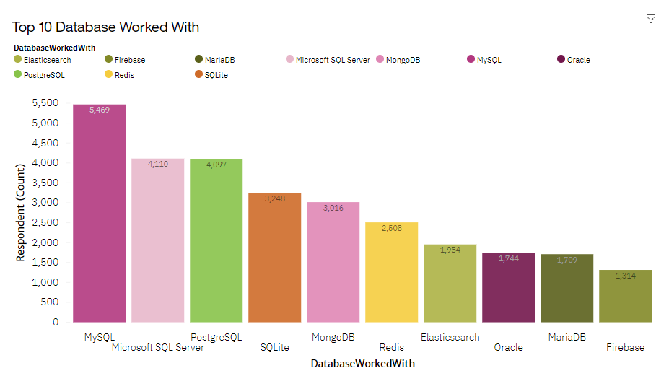
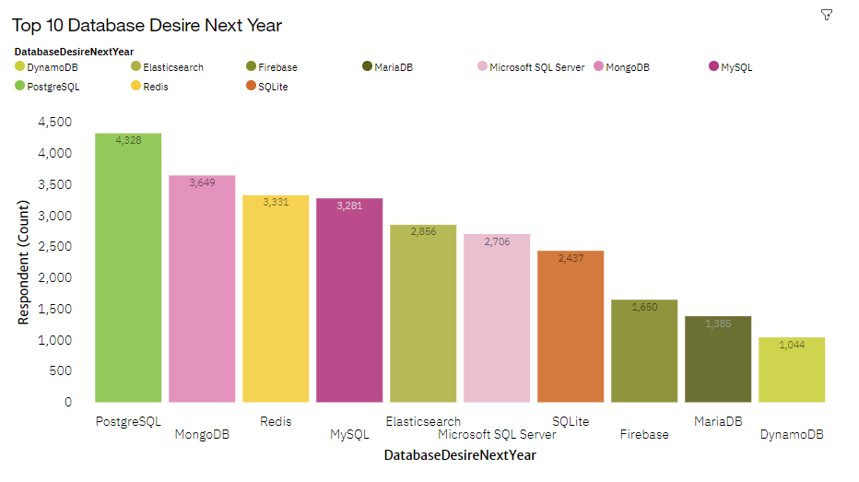
DATABASE TRENDS
Current Year
Next Year

Slide 10
DATABASE TRENDS-FINDINGS & IMPLICATIONS
Findings
SQL RDBMS are by far the most popular choice in 2019.
Postgres’s upward trend shows it's becoming the most popular SQL database.
MongoDB and Elasticsearch are on the rise.
Implications
Open-source databases are the most preferred.
NoSQL databases are gaining popularity quickly. Future developers may need skills in both SQL and NoSQL databases.

Slide 11
DASHBOARD
The permanent link of the read-only view of the Cognos dashboard goes here:
https://dataplatform.cloud.ibm.com/dashboards/92369562-c037-442b-b341-134e5d91c3bb/view/431cf81b1fb96fd053f2b5e407cf25027561705ae1bbd503d5d17b4907327697a93840c3c82a490ed3120666a7ed135d9f

Slide 12
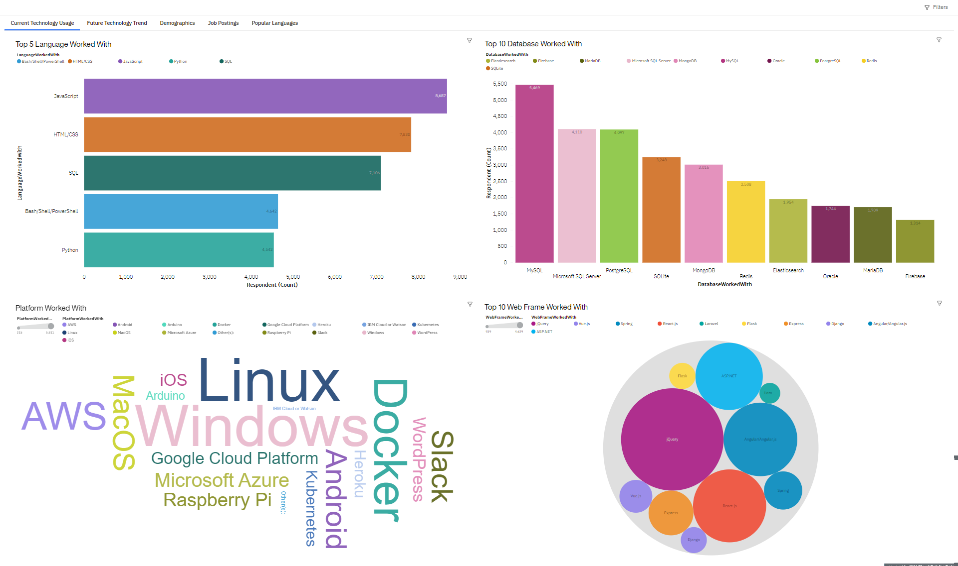
CURRENT TECHNOLOGY USAGE

Slide 13
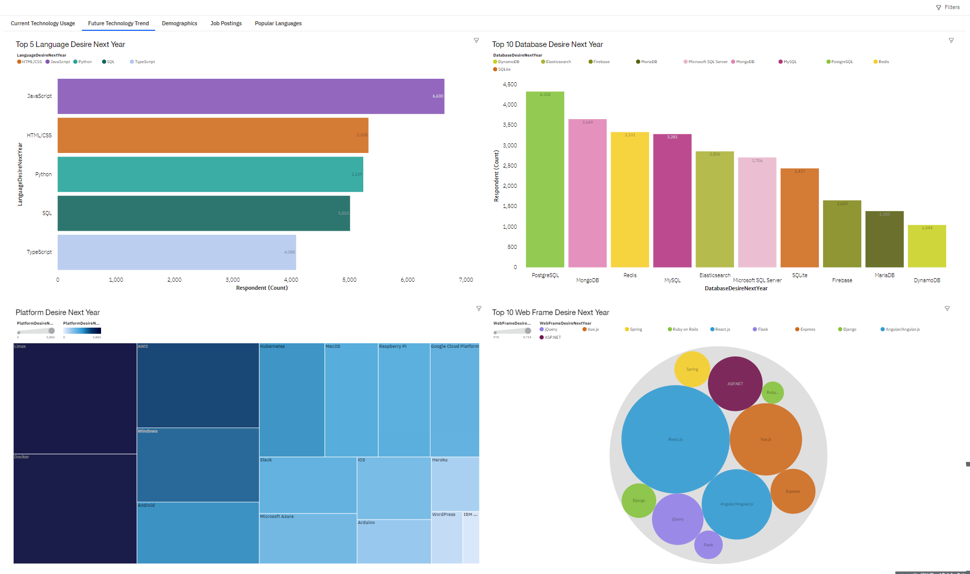
FUTURE TECHNOLOGY TREND

Slide 14
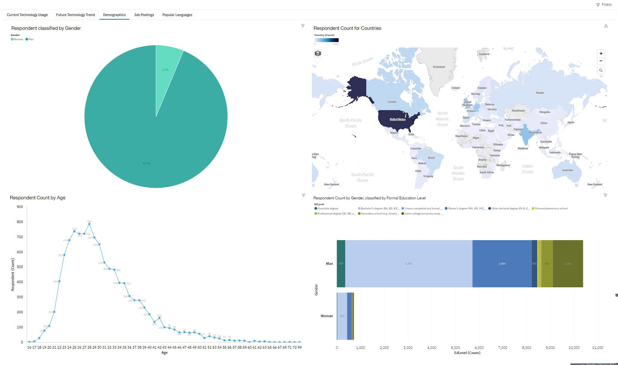
DEMOGRAPHICS

Slide 15
DISCUSSION

Slide 16
OVERALL FINDINGS & IMPLICATIONS
Findings
JavaScript and HTML are the most popular currently and remain so in the future.
SQL RDBMS are the most preferred, but NoSQL are gaining momentum.
Implications
Web developers are amongst the most wanted in the IT field.
Data Professionals need to learn both SQL and NoSQL databases.
As technology grows and becomes more mainstream, I believe the gender/country gap will shrink but we also need to do our part in closing the gap with equal opportunity.

Slide 17

CONCLUSION
After reviewing and analysing the survey subset conducted by Stacked Overflow in 2019, we can conclude the most rewarding languages, databases, platforms and web frames for current use and in the near future.
Technology is ever growing and expanding. Developers need to sharpen their skills on the technologies that are gaining popularity and may shape the future.
Recommendation:
Programming Languages: JavaScript, HTML / CSS, Python
Databases: MYSQL, PostgreSQL, MongoDB

Slide 18

APPENDIX

Slide 19
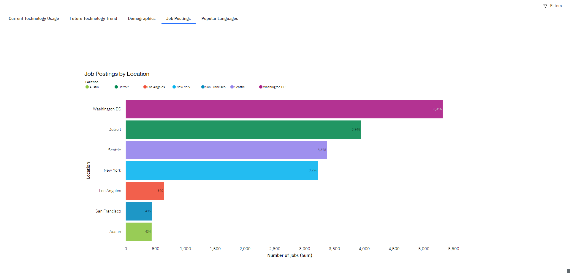
JOBS POSTING

Slide 20
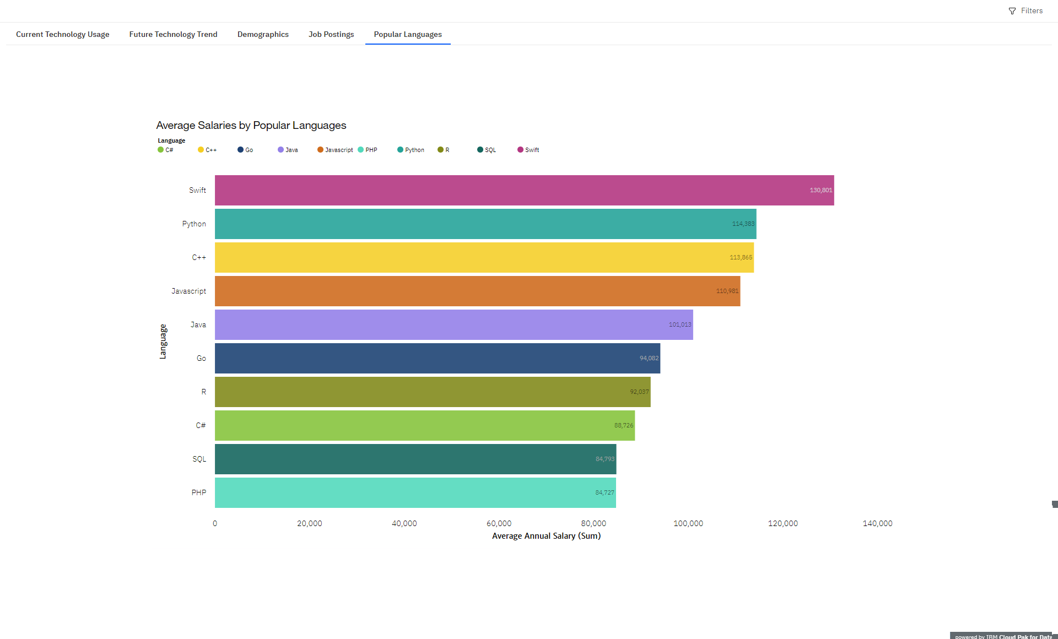
POPULAR LANGUAGES

